Slide 1

Cryptocurrency Prediction Using Fin-BERT and Time-Series Methods
GROUP-5
SAI HARSHA VARDHAN REDDY KOLAN
Venkata Sai Preethi Chilakala
Sandeep Jakkula
Azmat Ahmed Shaik

Slide 2

MOTIVATION
Navigating Market Volatility
Markets are inherently unpredictable due to numerous influencing factors.
Uncertainty is driven by both internal market dynamics and external events, making risk management crucial.
RISK REDUCTION, PROFIT MAXIMIZATION
UTILIZING ADVANCED MODELS CAN HELP MITIGATE RISKS AND IDENTIFY PROFITABLE OPPORTUNITIES.
MACHINE LEARNING MODELS OFFER SUPERIOR DECISION-MAKING THROUGH DATA-DRIVEN INSIGHTS.
Limitations of Traditional Models (Holt-Winters & ARIMA)
Conventional models, like Holt-Winters and ARIMA, struggle to capture non-linear relationships and external shocks, as they rely heavily on historical data and trends. This makes them less adaptable to real-time market shifts driven by external factors like sentiment and geopolitical events.
While effective for trends and seasonality, these models lack the flexibility needed to respond quickly to short-term volatility, limiting their ability to navigate complex, rapidly changing market conditions.

Slide 3

RESEARCH QUESTIONS
HOW CAN NEWS DATA BE INCORPORATED INTO PREDICTIVE MODELS FOR ACCURATE CRYPTO PRICE PREDICTION?
How RECUURENT NEURAL NETWORKS LIKE LSTM IS USED IS USED TO PREDICT CRYPTO PRICES FROM FINANCIAL NEWS?
How can transformer models LIKE BERT SUITABLE for text generation be adopted for numerical CRYPTO PRICE forecast?
How SEMANTIC SEARCH improves the model predictions?

Slide 4





DATA SOURCE
Over 400 cryptocurrency news articles sourced from a public database hosted on a GitHub repository from Sep-2017 to July-2024
Data pre-processing
Final Data
Ready for modeling
Crypto Prices sourced from CoinCodex Website.

Slide 5
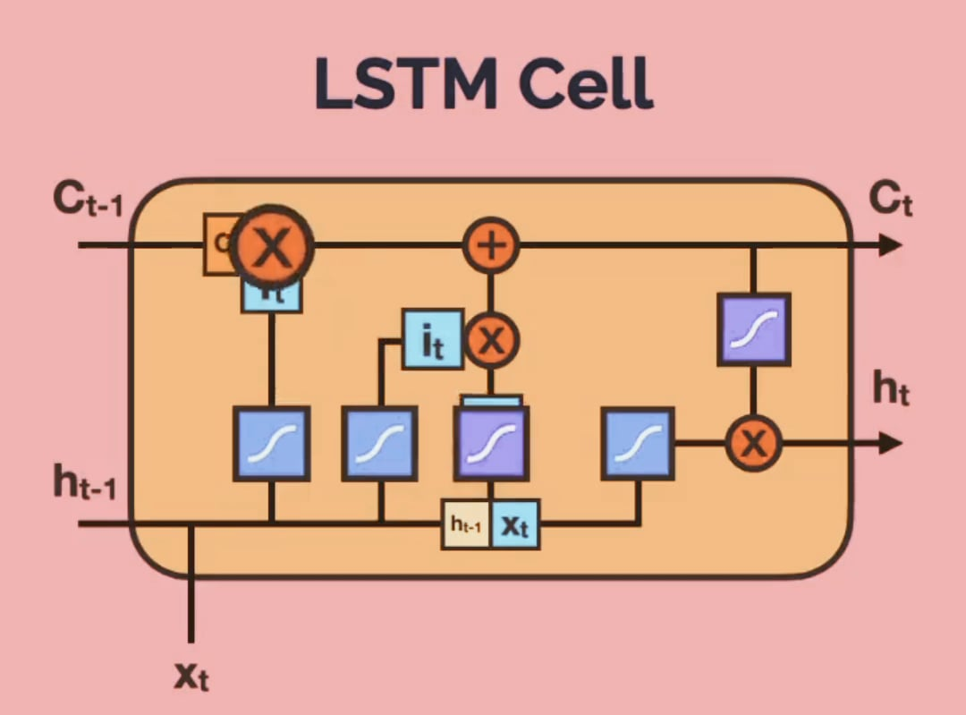
METHODOLOGY USING LSTM
Training Data
GloVe Embeddings
Loss function
Prediction
Actual
Linear Layer
Prediction

Slide 6
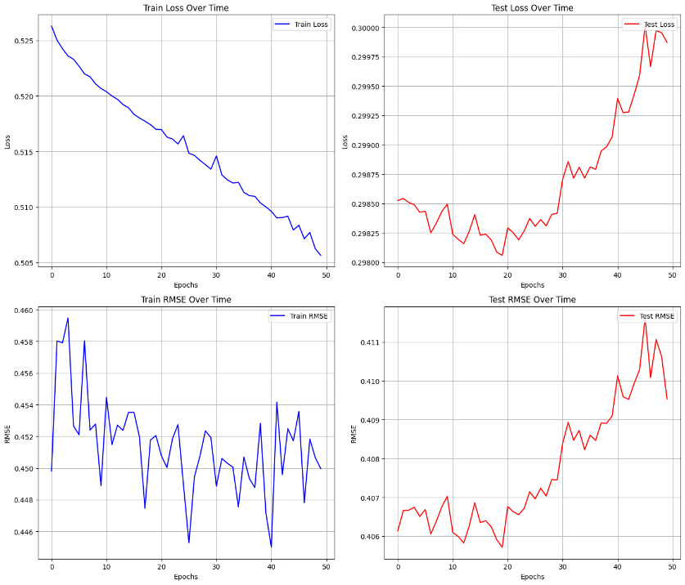
LSTM Performance Evaluation
LOSS: MSE (Mean Squared Error)
NUMBER OF EPOCHS: 50
EVALUATION METRIC: RMSE (Root Mean Squared Error)
HIDDEN STATES: 128
BEST EPOCH: 20
MINIMUM TEST LOSS (MSE): 0.29
MINIMUM TEST RMSE : 0.40
DRAWBACKS:
Vanishing Gradients
Static Glove Embeddings

Slide 7
Methodology USING FINBERT
Crypto-NEWS HEADLINES
TF- IDF VECTORIZER
VECTOR EMBEDDINGS
FAISS
QUERY-VECTOR EMBEDDING
LINEAR LAYER
ATTENTION-ENHANCED EMBEDDINGS
TOP 5 STOCK HEADLINES EMBEDDINGS
FINBERT
PREDICTION
LOSS FUNCTION
ACTUAL

Slide 8
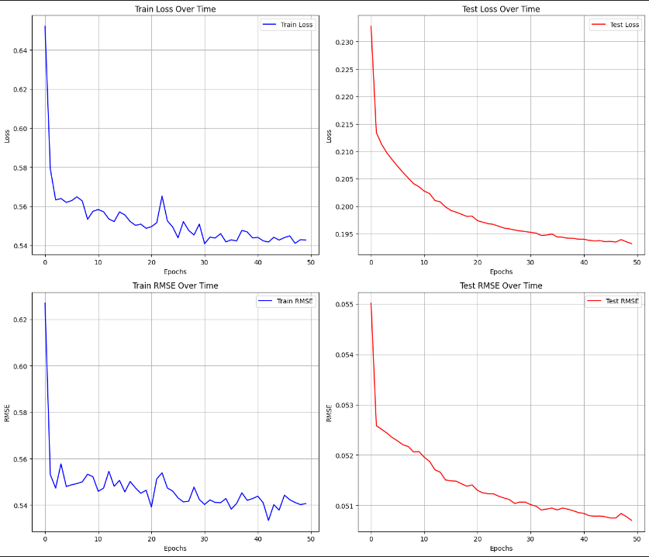
Fin-Bert Performance Evaluation
LOSS: MSE (Mean Squared Error)
NUMBER OF EPOCHS: 50
EVALUATION METRIC: RMSE (Root Mean Squared Error)
HIDDEN STATES: 768
MAXIMUM TOKEN LENGTH: 64
BEST EPOCH: 50
MINIMUM TEST LOSS (MSE): 0.19
MINIMUM TEST RMSE : 0.05

Slide 9
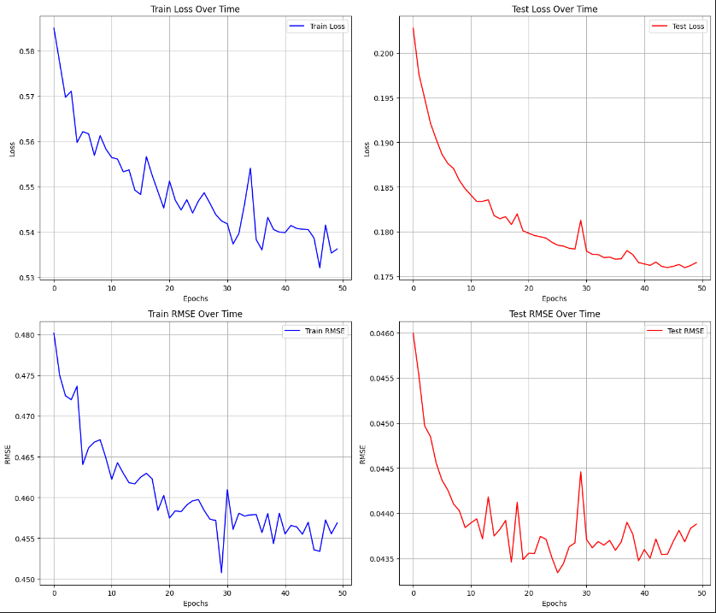
Fin-Bert Performance Evaluation Using Semantic Search (IndexFlatL2)
LOSS: MSE (Mean Squared Error)
NUMBER OF EPOCHS: 50
EVALUATION METRIC: RMSE (Root Mean Squared Error)
HIDDEN STATES: 768
MAXIMUM TOKEN LENGTH: 64
BEST EPOCH: 48
MINIMUM TEST LOSS (MSE): 0.17
MINIMUM TEST RMSE : 0.04

Slide 10

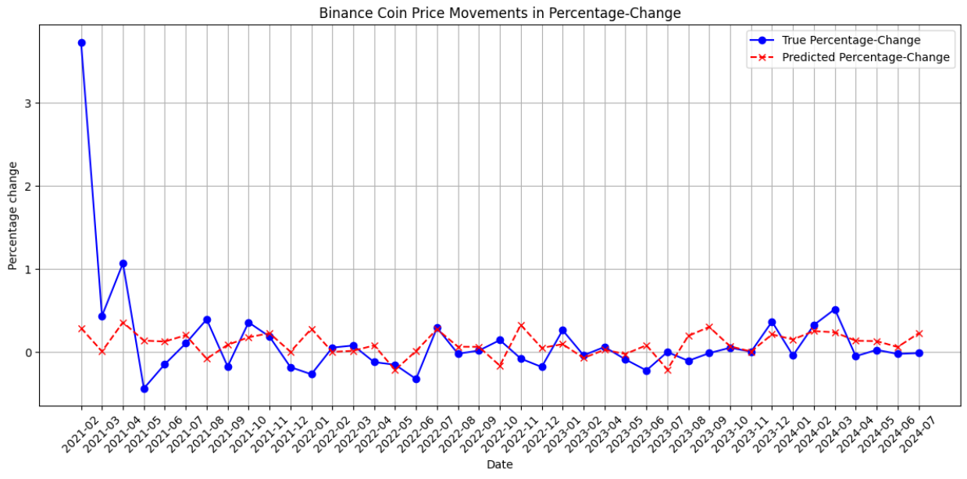
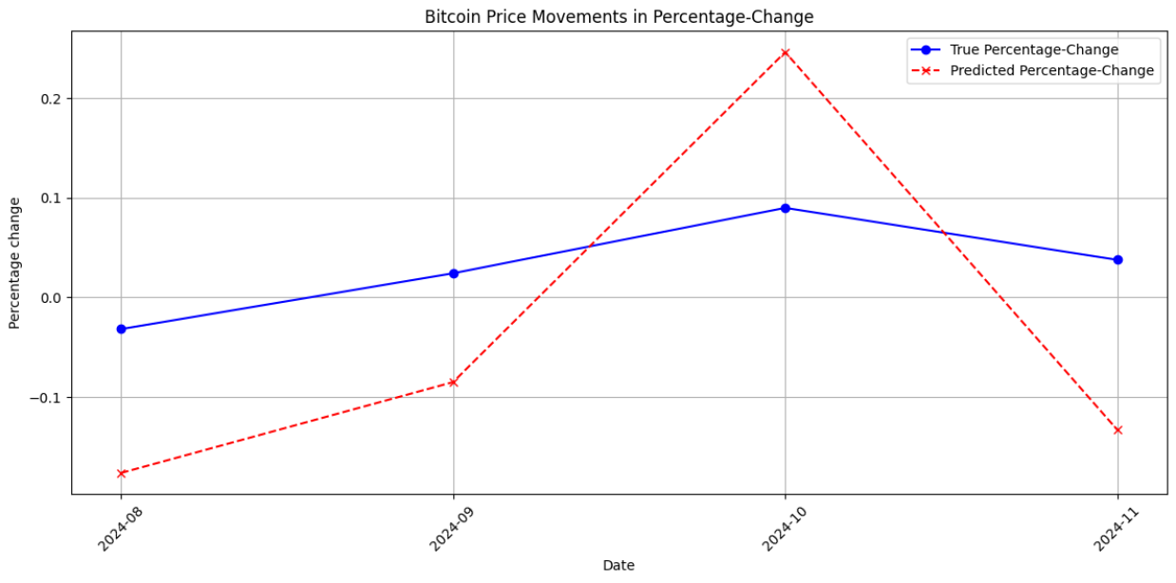
Performance Evaluation On Bitcoin
Training Till July-2024
Performance on Test Data (Aug-2024 – Nov-2024)

Slide 11
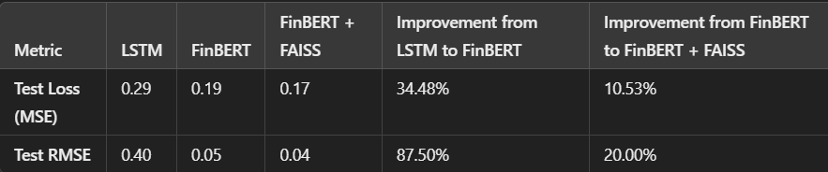
Conclusion & Future Work
Performance Comparision
Future Improvements
Integrate APIs like Polygon API for live crypto prices and Bing Search News or Yahoo Finance API for up-to-date financial news.
Build robust data pipelines to automate the ingestion and preprocessing of real-time data for seamless model updates.
Incorporate Retrieval-Augmented Generation (RAG) systems to enhance insights by combining live data retrieval with the model's responses.
Design and develop a user-friendly web application to serve as the interface, enabling users to interact with the model and access real-time insights.
When working with similarity search we can use IVF (Inverted File Index) or HNSW (Hierarchical Navigable Small World) algorithms to improve speed for large datasets.

Slide 12

Thank you
- GROUP 5

